Slide 1

Bubble Tea
Exploring the food trend in the top 10 US cities from Yelp

Slide 2
Contents
What is it and Why?
Data Collection
Findings
Conclusion and Future Works

Slide 3
What is it and why?
Notes:
Consider talking about:
Variants

Slide 4

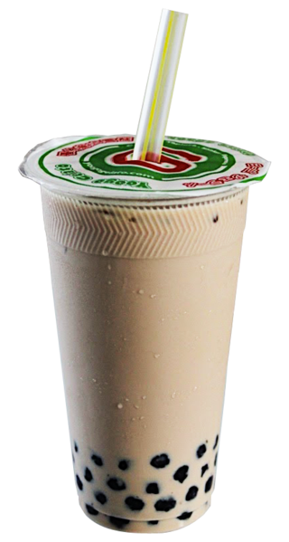
History
Bubble tea is a Taiwanese tea-based drink invented in Tainan and Taichung in the 1980s

Slide 5
Growth Potential
Fortune Business Insights:
The global bubble tea market size was USD 2.02 billion in 2019
Projected to reach USD 3.39 billion by the end of 2027

Slide 6
Target Audience
Potential investors looking into taking part in the bubble tea business:
Is the business really growing?
Who are the biggest players?
Where are the places worth investing?

Slide 7
Data Collection
Notes:
Consider talking about:
Variants

Slide 8
Scope
Top 10 cities by population
New York
Los Angeles
Chicago
Houston
Phoenix
Philadelphia
San Antonio
San Diego
Dallas
San Jose
Has the label “Bubble Tea”
At least 1 review
About 1200 stores after cleaning

Slide 9
Web-Scrapping
Scrapped all qualified bubble tea search results on Yelp with Scrapy
Issue:
CAPTCHA
Missing fields when running same code
Solutions
Less results per crawl then combine
Job directory for manual pausing
Reruns
Notes:
Originally wanted top 50 cities
Kept getting checked on - fortunately not blocked
JOB Directory to manually pause collection

Slide 10
Findings
Notes:
Mainly exploratory

Slide 11
Growing Trend – for the past 15 years
Notes:
Growing until 2020 for the past 15 years… likely due to COVID - 19

Slide 12
Growing Trend by City

Slide 13
City Statistics Comparison
City | Average Rating | Total Reviews | Location Count | Avg. Review/Loc
San Jose | 3.70 | 56,004 | 210 | 267
New York | 3.87 | 21,778 | 206 | 106
Houston | 3.84 | 20,857 | 196 | 106
Dallas | 3.79 | 17,952 | 162 | 111
Los Angeles | 3.91 | 38,298 | 121 | 317
Chicago | 3.80 | 8,799 | 89 | 99
Phoenix | 3.81 | 11,745 | 81 | 145
Philadelphia | 3.80 | 5,173 | 72 | 72
San Antonio | 4.03 | 3,482 | 38 | 92
San Diego | 3.60 | 4,389 | 25 | 176
Notes:
Not very big difference in rating
LA/PHX/SD

Slide 14
Zip Codes with the Most Stores
77036: Houston's China town
95035: Milpitas
95122: East San Jose
10013: Lower Manhattan
95014: Cupertino
77072: Houston area with a lot of Asian restaurants
10003: Left part of East village
75075: Houston area with a lot of Asian restaurants
Notes:
Tends to be close to business area with Asian roots (restaurants/markets)

Slide 15
Biggest Players – top 20 by branch
Top 20 chains take up 20% of the total stores in scope
Notes:
Takes up 20% of the total stores

Slide 16
Top Bubble Tea Chain Expansions
Notes:
Estimated by first review date on Yelp

Slide 17
Conclusion and Future Works
Notes:
Consider talking about:
Variants

Slide 18
Conclusion
Is the business really growing?
Overall, yes, but but dip in 2020
Who are the biggest players?
Kungfu tea
Gongcha
Sharetea
Where are the best locations to invest in?
Cannot conclude as of now, which leads to the next steps

Slide 19
Next Steps
Expand city locations
From top 10 to top 50 cities so trends may become more obvious
What contribute to stores being popular?
High number of reviews at certain locations
Age/race/income
Near by business/facilities
Web-scrapping process improvement
Potentially using additional services to swap IP periodically

Slide 20

Works Cited
Wikipedia: https://en.wikipedia.org/wiki/Bubble_tea
Fortunebusinessinsites:
https://www.fortunebusinessinsights.com/industry-reports/bubble-tea-market-101564
Yelp
https://www.yelp.com

